Slide 1

Samuel Adames
James David
AJ DiSimone
Ana Pineda

Slide 2
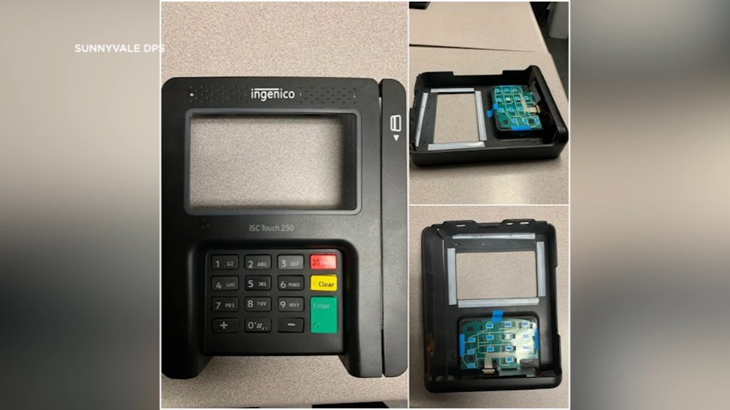
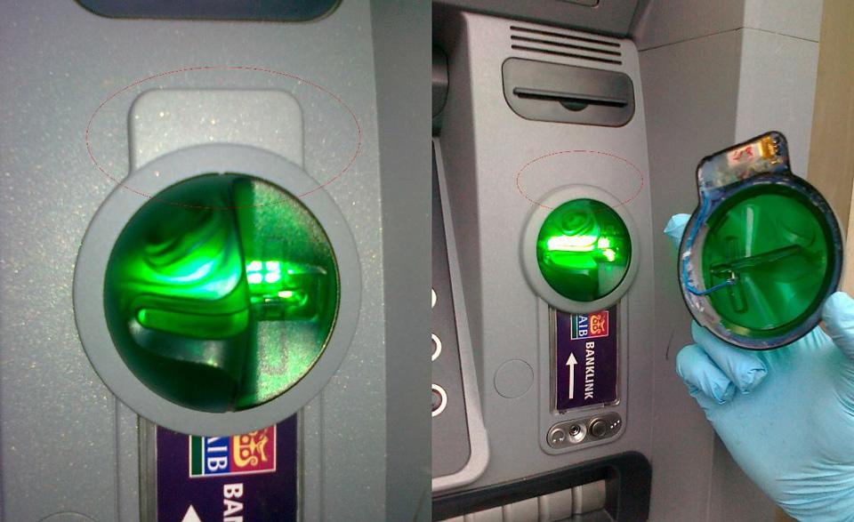
What are Credit Card Skimmers?
Skimmers are a device installed on card readers that collects card numbers
Hard to detect because they are usually perfectly fitted for the top of card readers
Used by scammers to recover and use this information for fraudulent purchases

Slide 3
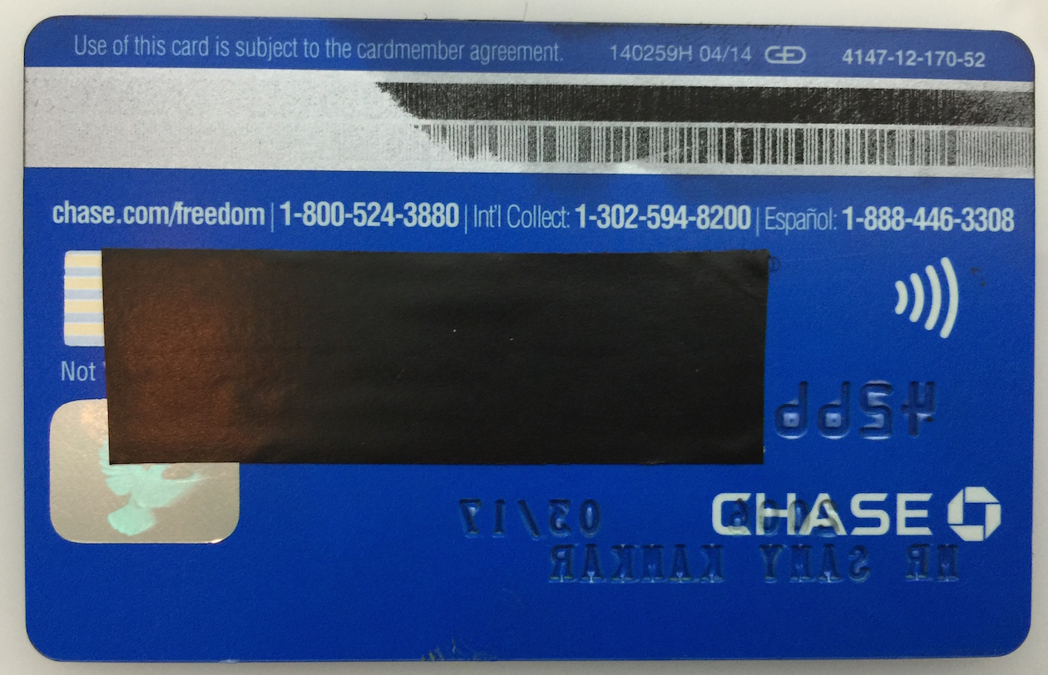
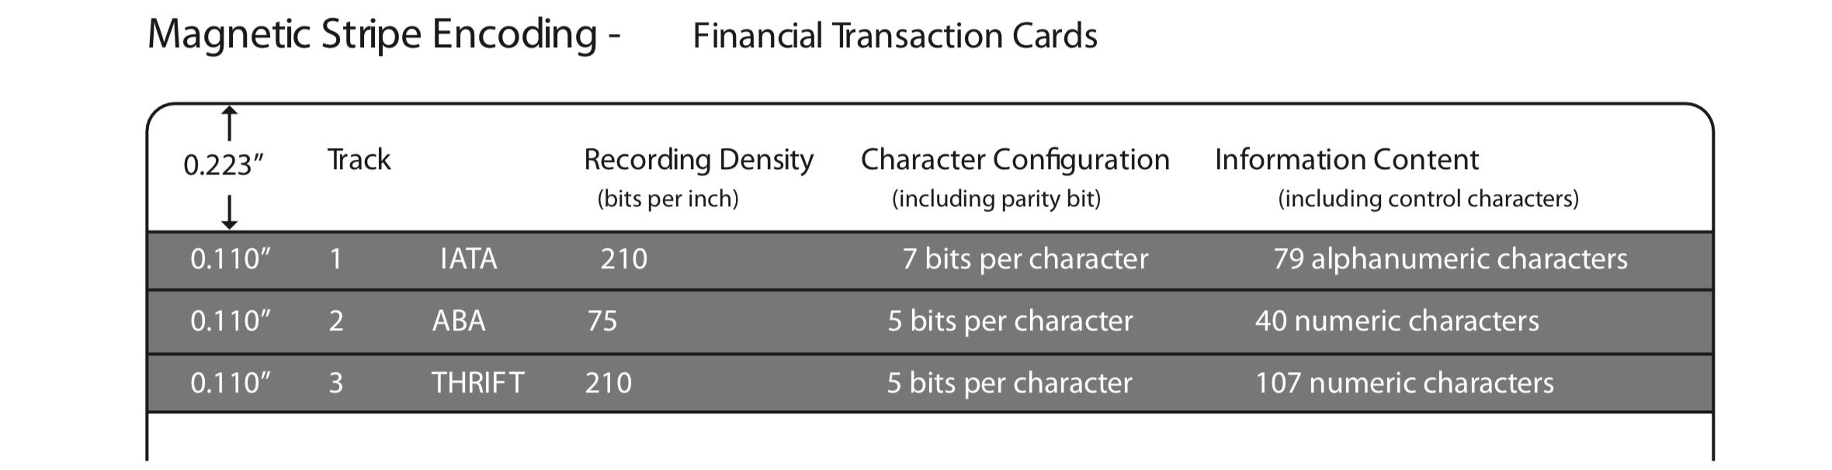
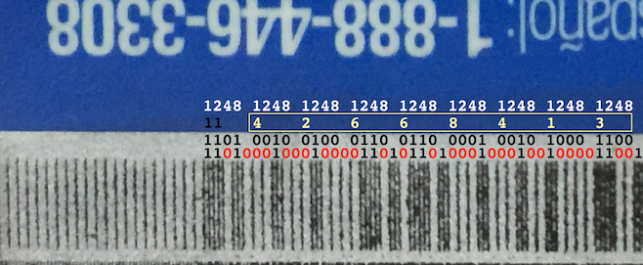
Research - Credit Cards
The information of the credit card is encoded within the magstripe
Mini vertical lines are magnetic flux lines caused by ferromagnetic particles
Flux lines have different polarities, which determines its information
Notes:
This is a visual for how the individual tracks are laid out in accordance with the ISO standards, with each track shown and all dimensions labeled, along with what the length of data is for each track and section and it’s recording density

Slide 4
Research - Standards
ISO/IEC 7810: Defines physical characteristics for ID cards
Includes dimensions, resistance to external factors, and toxicity
ISO/IEC 7811-1 through 7811-9: Standards for the recording technique for ID cards
location of the read-only/read-write tracks, the embossing of the card
ISO/IEC 7813: Defines properties of financial transaction cards (e.g. credit cards)
Defines both physical characteristics like size, shape, location of the stripe and the data structure of the mag track
Notes:
Embossing: the stamping process of raised or sunken parts of the card
ISO seems to have separate standards for ID cards and Financial Cards

Slide 5
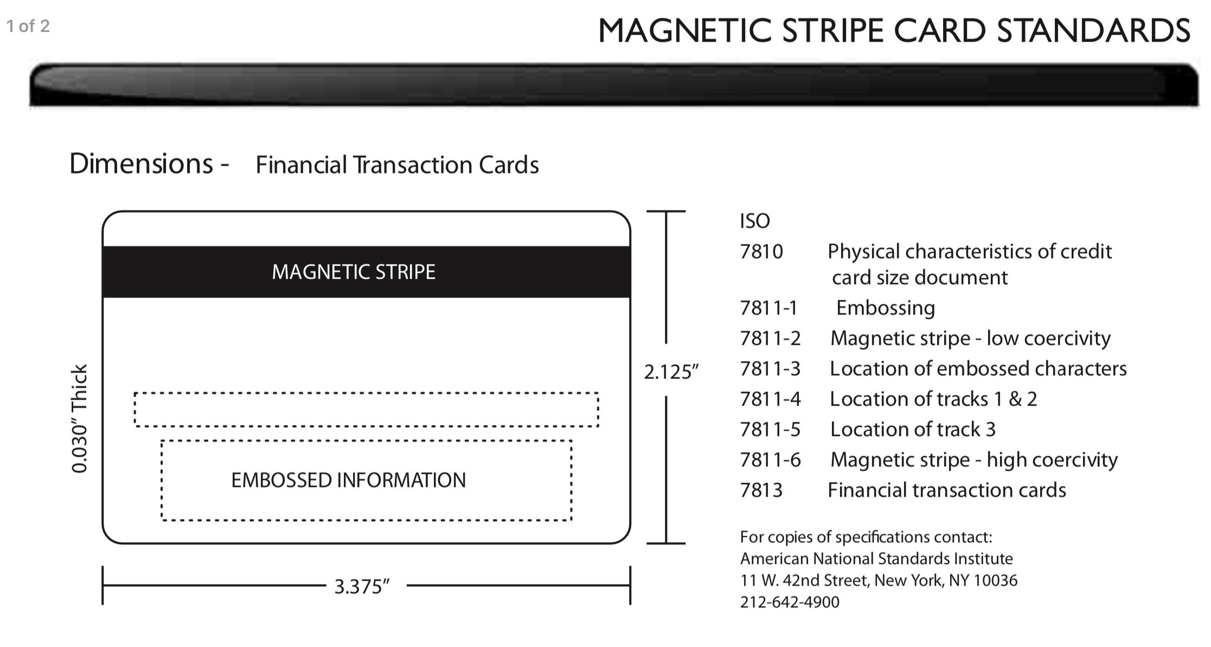
Notes:
This is a visual for how the ISO standards define how a magstripe card should look like, with all dimensions and locations of tracks clearly defined

Slide 6
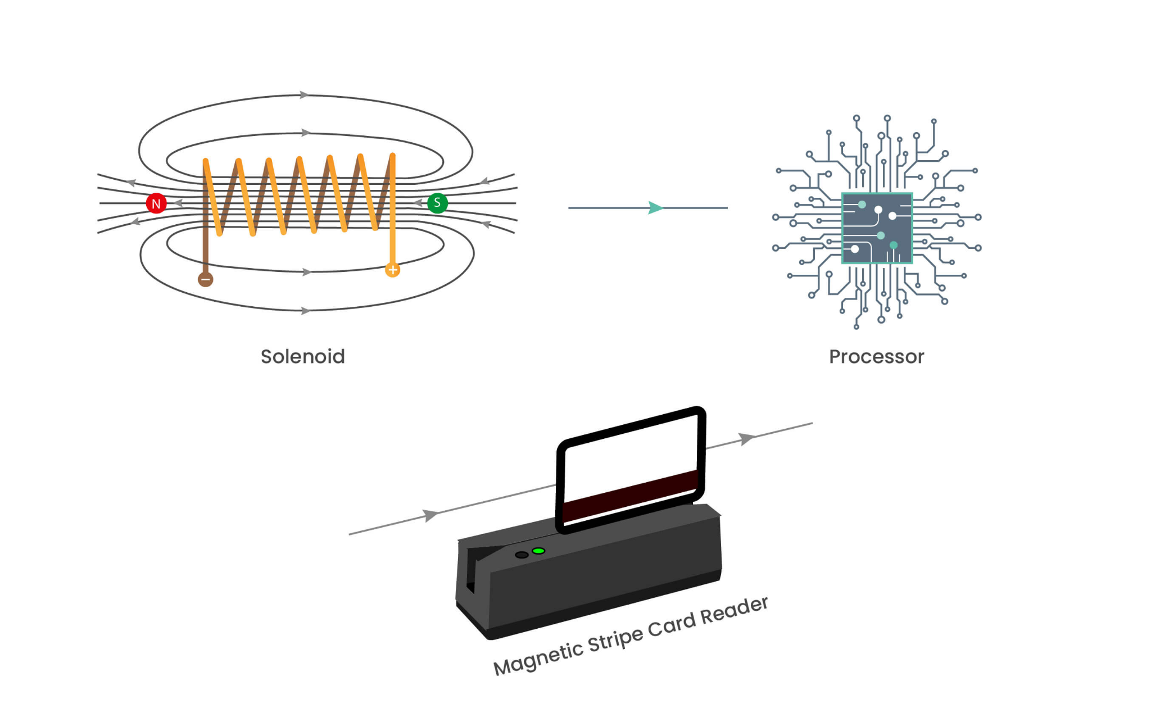
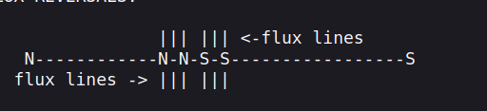
Research - Card Readers
A card reader is essentially a solenoid
Reading the credit card consists of reading the flux reversals on the card
The read head reads the information by detecting the changes in the magnetic field caused by the flux reversals on the badges magnetic stripe.
Electromagnetic Reciprocity
Notes:
ELECTROMAGNETIC RECIPROCITY: current passing thru a solenoid produces a
magnetic field at the gap, therefore, the presence of a magnetic field at the
gap of a solenoid coil will *produce a current in the coil*! The strongest
magnetic fields on a magstripe are at the points of flux reversals.

Slide 7
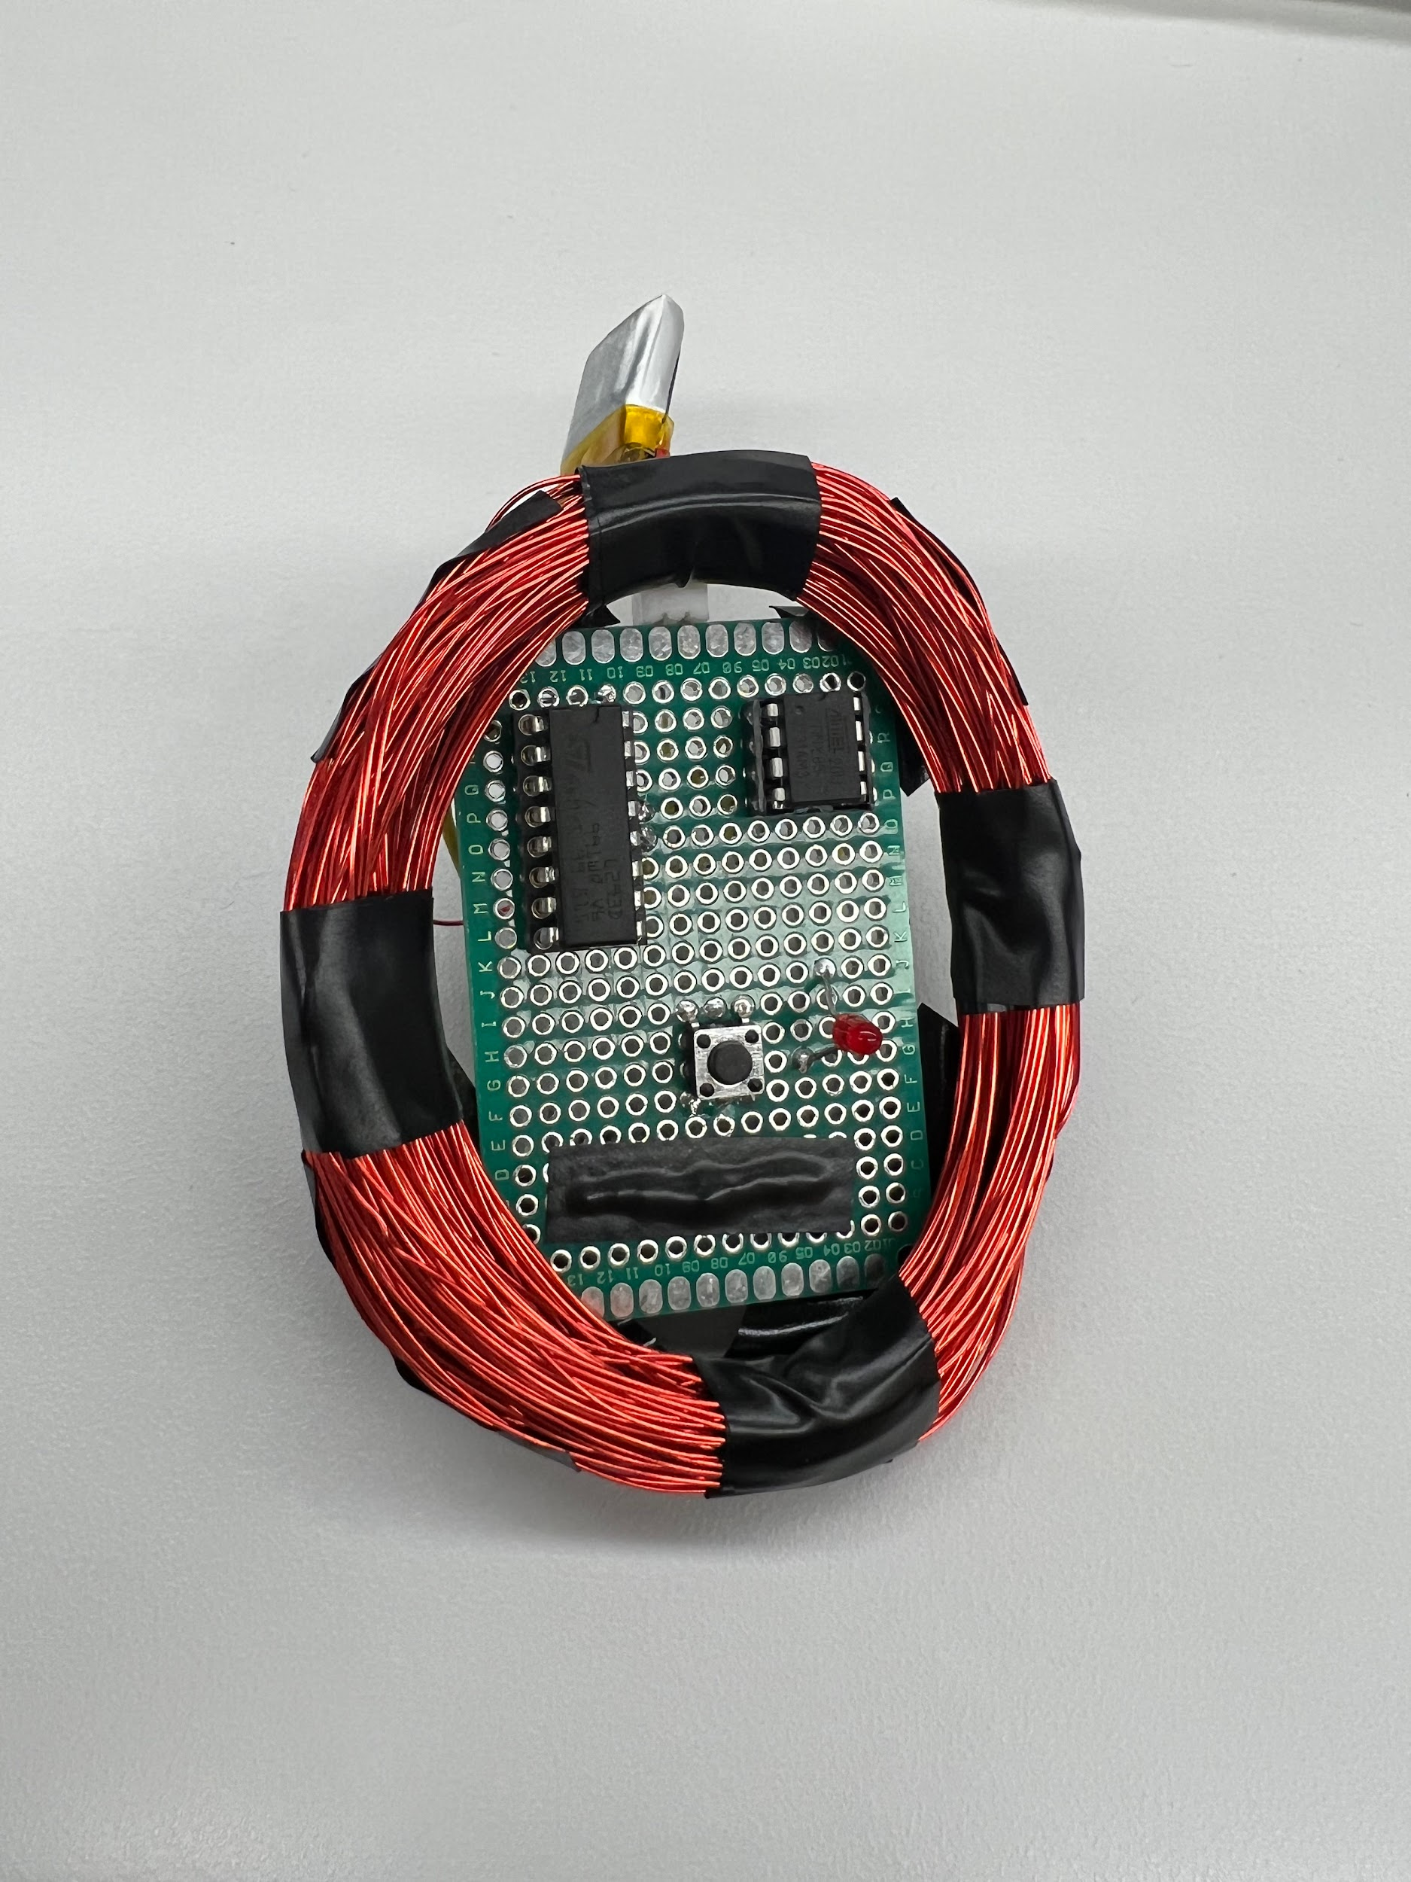
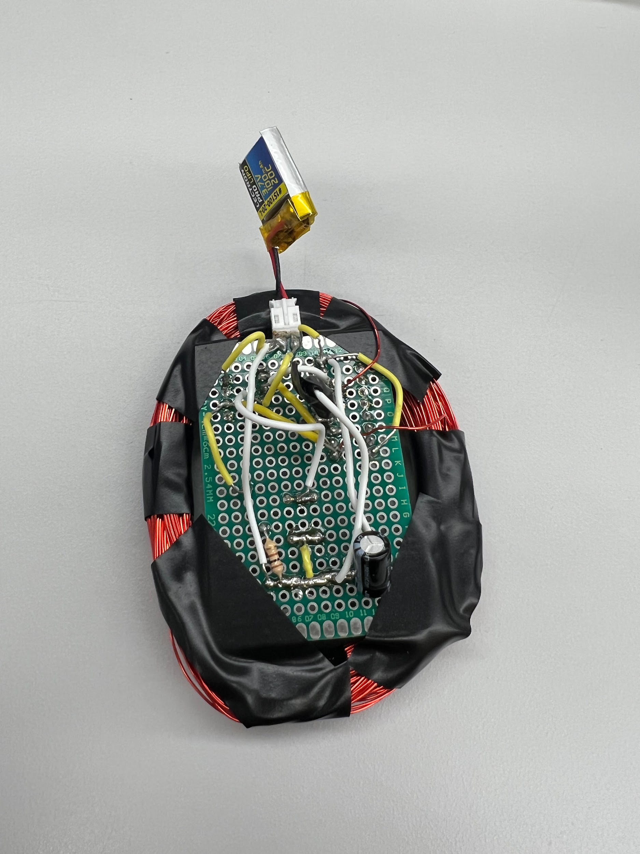
MagSpoof & Benefits
Wireless credit card spoofer that allows you to store your cards in one device.
It works by producing a magnetic field similar to a magnetic stripe with a quick-changing polarization of an electromagnet.
Devices allows us to perform research in other areas of magnetic stripes.
Benefits
Provided better understanding how magnetic stripes work
Uses concepts of electromagnetism

Slide 8
The Magnetometer
A magnetometer is a device used to measure the magnetic field for three physical axes (x, y, z).
Originally planned to use this device to measure the changes in the magnetic field around the card reader.
Most magnetometers are referred to as Solid-State Hall Effect sensors.

Slide 9
The Magnetometer - How it Works
For magnetometers using the Hall effect:
These sensors specifically work by using an electrical current that is affected by the presence of a magnetic field that does not run parallel to the direction of the current.
When a magnetic field present, the electrons in the current gather on one side of the material, while in the absence of a field, the electrons run in a straight line.
The behavior of the electrons can be measured to determine the direction of the magnetic field.

Slide 10
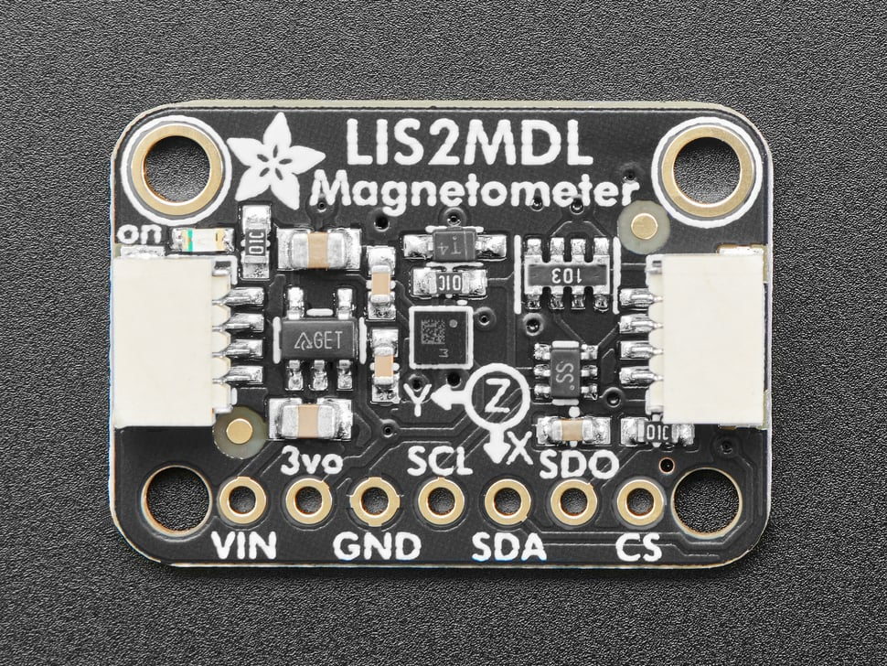
The Magnetometer - LIS2MDL
We originally planned to work with the LIS2MDL
because we found it to be a good option for the following reasons:
High Sensitivity: It can detect small changes in the magnetic field.
Wide Measurement Range: The device has a magnetic field dynamic range of ±50 gauss.
Low Power Consumption: Uses very little power, which makes it ideal for use in battery-powered devices.
Small Size: Can be integrated into a range of devices.

Slide 11
The Magnetometer - Why We Chose to Switch
After testing the magnetometer, we found it was not what we expected for the following reasons:
The LIS2MDL was too sensitive to electromagnetic interference (EMI) and was producing inaccurate measurements even after being calibrated.
In general, there was too much EMI from all the devices surrounding the sensor (computer, phones, etc) even after moving to a more quiet location (e.g., outside).
Looked into magnetic shielding to help reduce the amount of EMI that reaches the magnetometer by providing a conductive barrier between the sensor and sources of interference, but found it did not align well with our design overall.

Slide 12
Current Sensor
Through more research, we found that a current sensor was a more appropriate choice than a magnetometer for measuring the change in magnetic field.
By measuring the induced current flowing through the card reader using a current sensor, we can better gauge a threshold value to have a way to determine a skimmer
To test the sensor, we decided to first measure what current came out of the card reader when a card was swiped

Slide 13
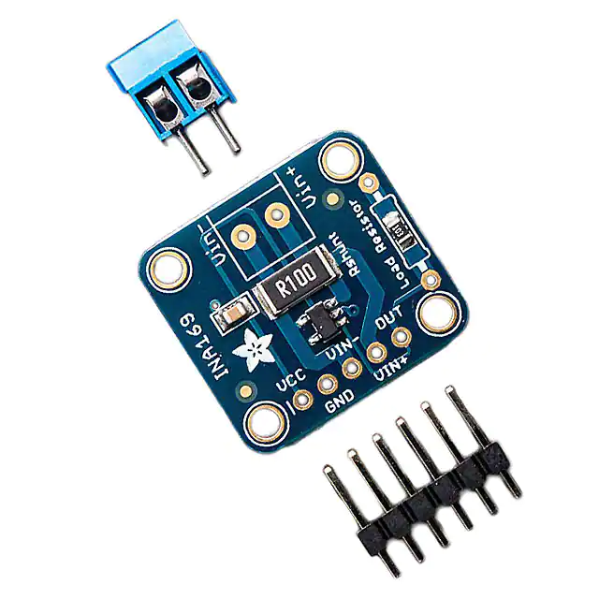
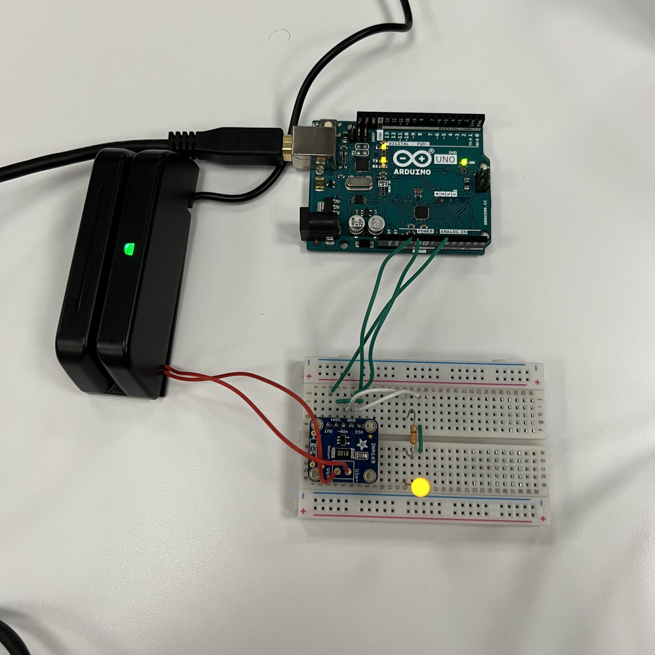
Current Sensor - INA169
The INA169 breakout board module enables you to
conveniently measure DC current draw while providing
an analog output that is relative to ground.
We connected this module in series with our card
reader and measured differences between 1 swipe
and 2 fast swipes

Slide 14
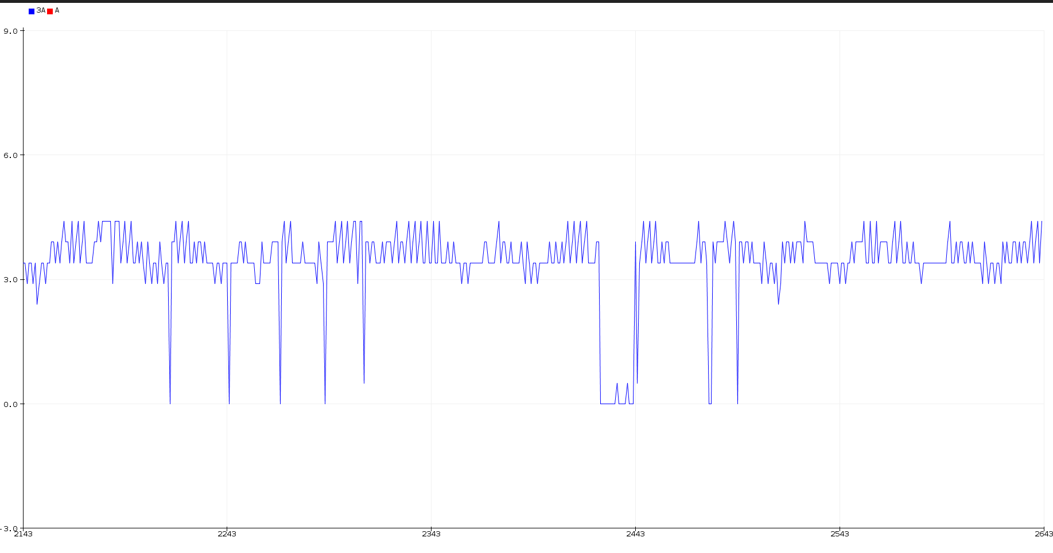
Current Sensor: 1 Swipe vs 2 Swipes

Slide 15
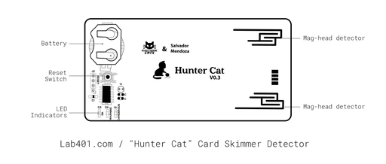
The Hunter Cat
The Hunter Cat is a device currently being produced by Electronic Cats that is essentially what our group is trying to accomplish.
The device can detect a skimmer on ATMs and PoS devices without risking your real data.
Detects the number of magnetic stripe heads

Slide 16
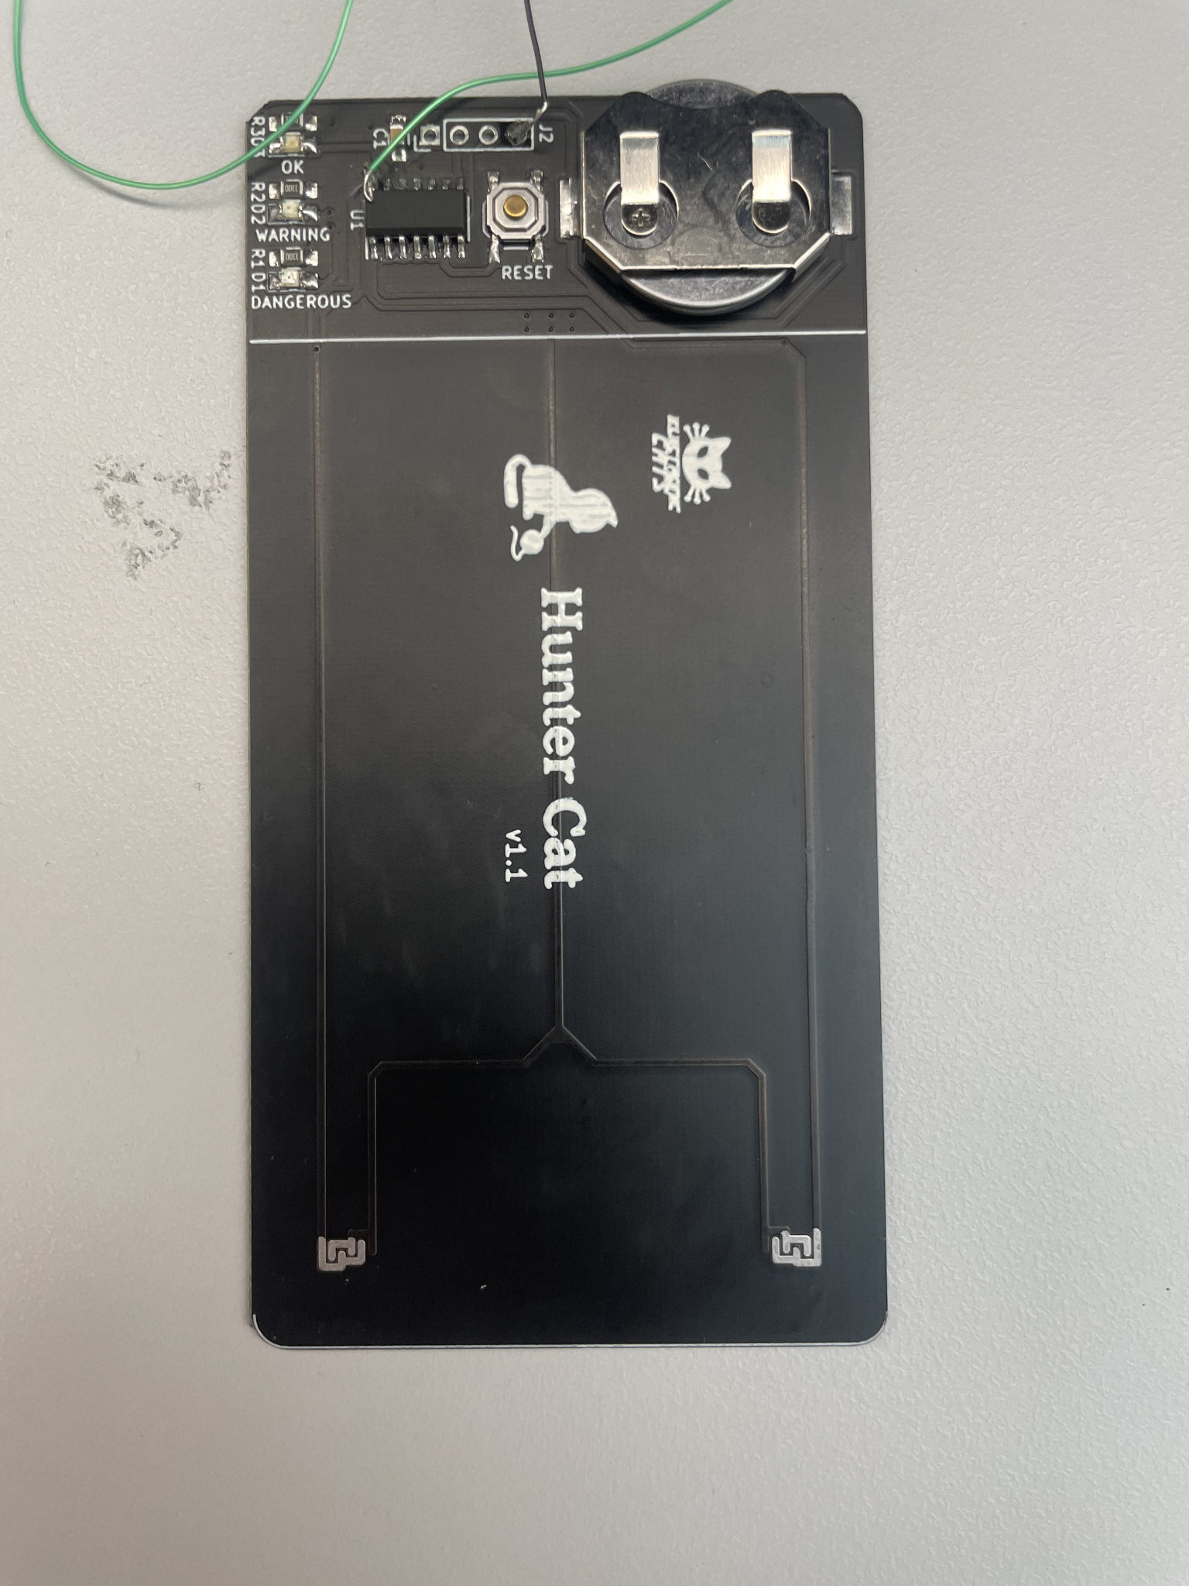
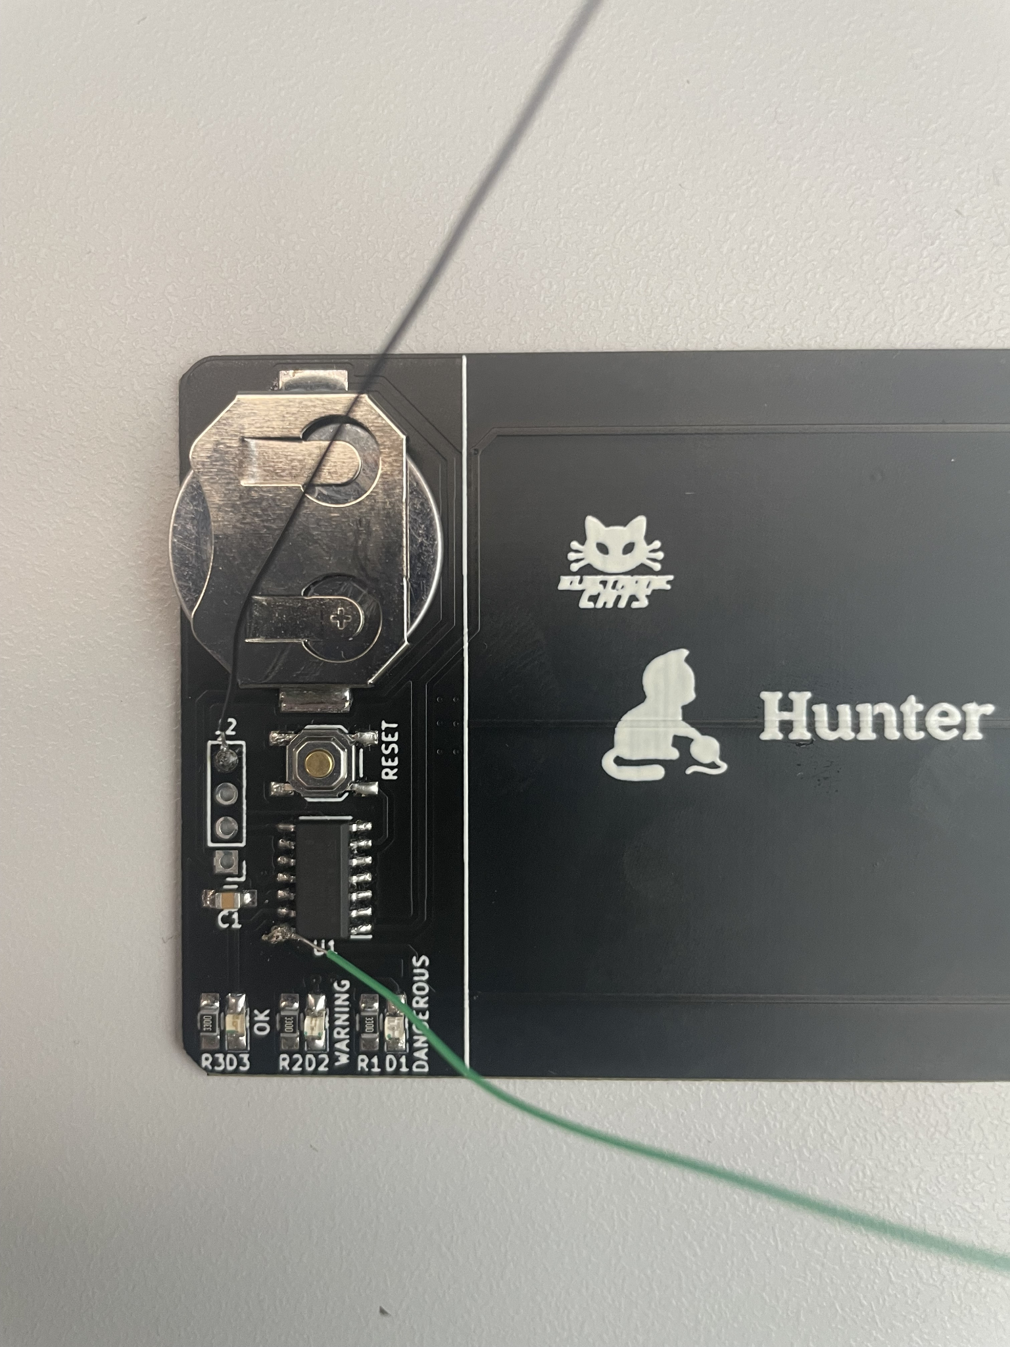
The Hunter Cat - Induced Current Testing
Just like all cards, the Hunter Cat produces an induced current when swiped through card reader
Believed the Hunter Cat collects this induced current and converts it to a digital signal for microprocessor to read and set threshold
Wanted to measure amount of induced current Hunter Cat was collecting via its coils when swiped

Slide 17
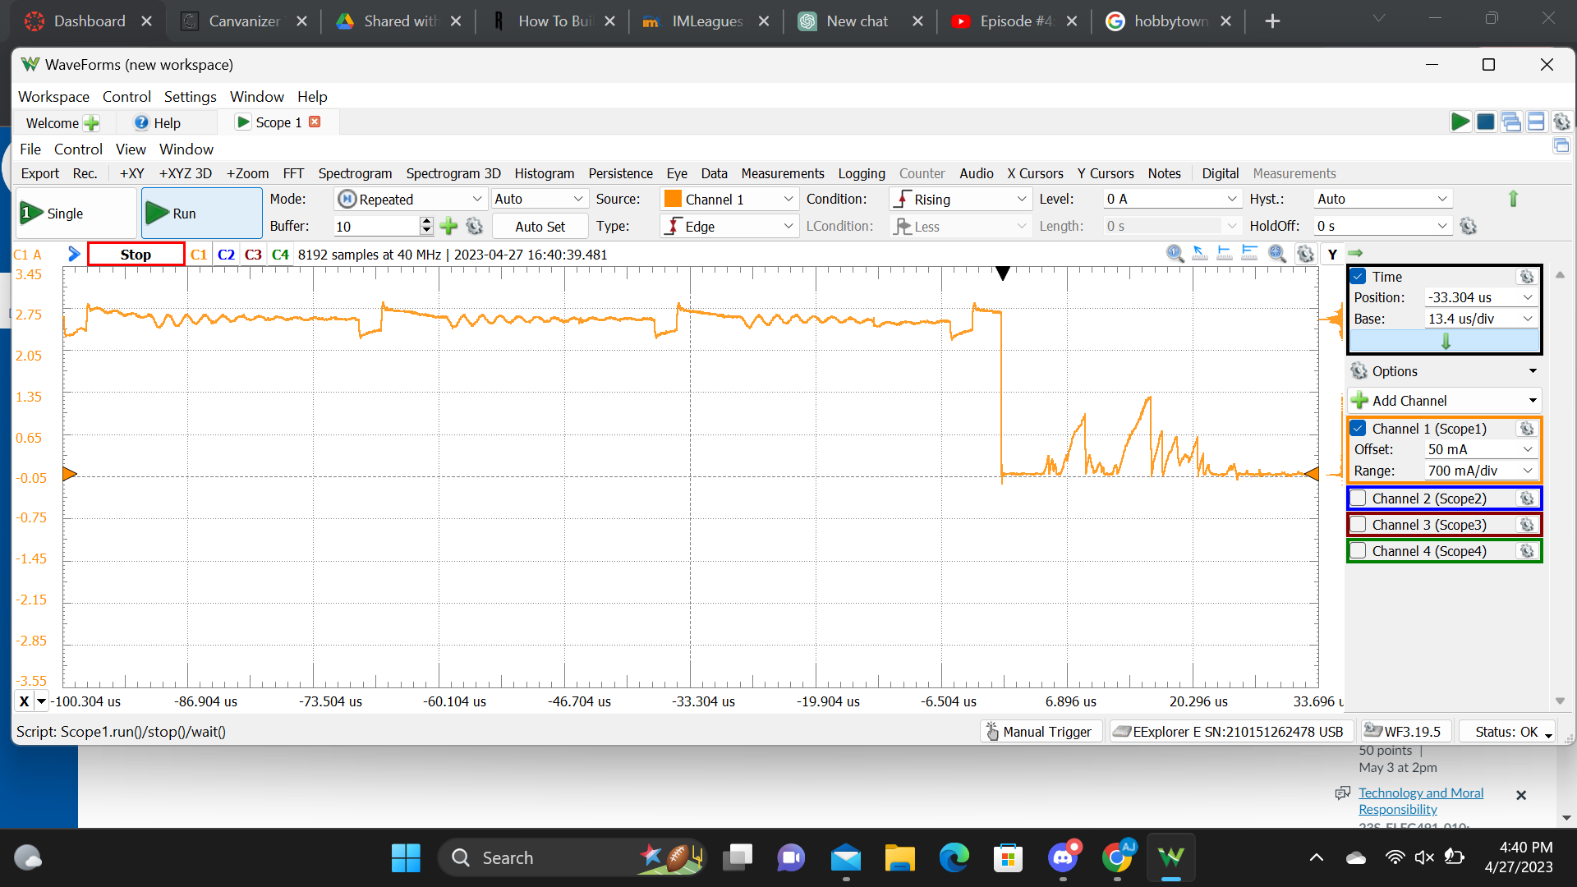
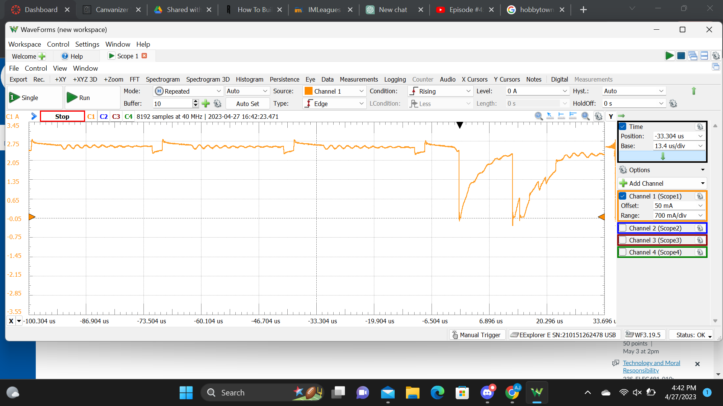
Waveforms Graph With 1 Swipe
Waveforms Graph With 2 Swipes

Slide 18



Reversing the Hunter Cat
Why we chose to reverse engineer the
Hunter Cat:
Alignment with project goals
Cost efficient
Improvement and Customization

Slide 19
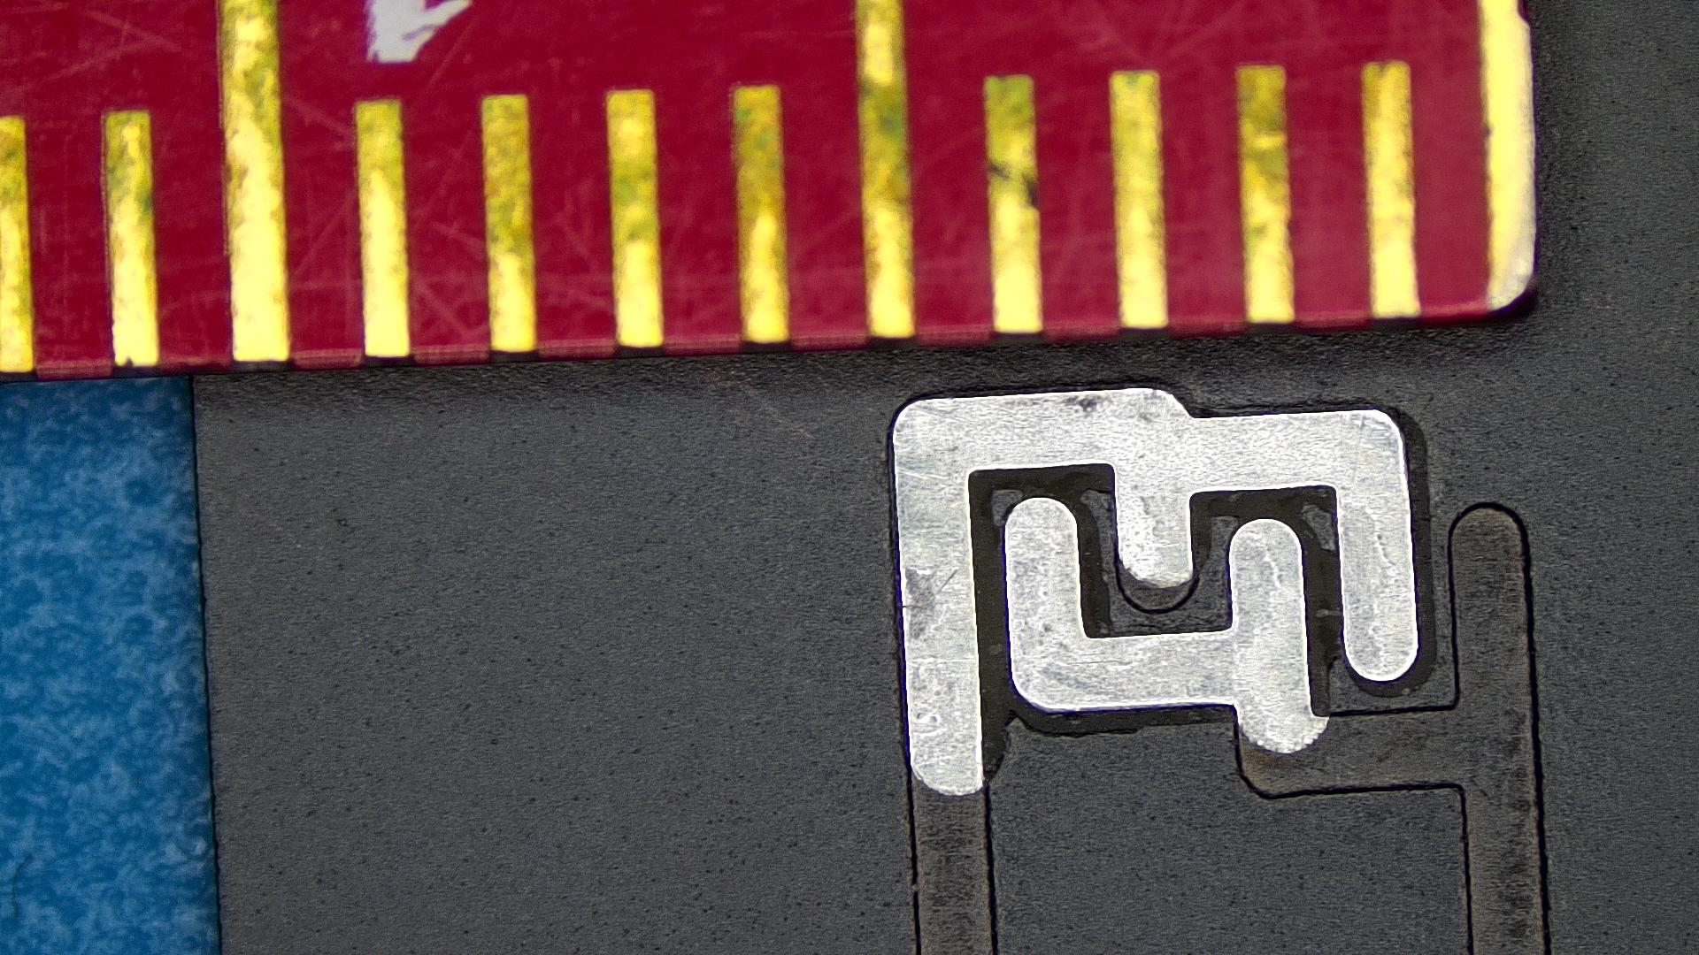
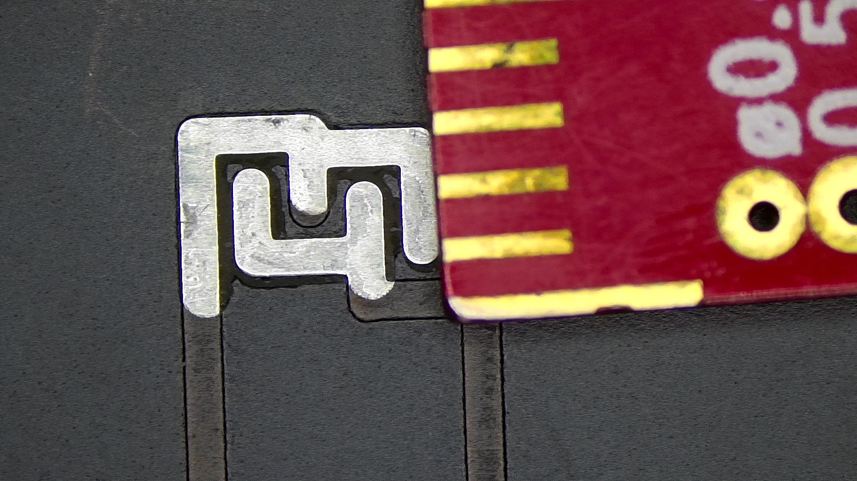
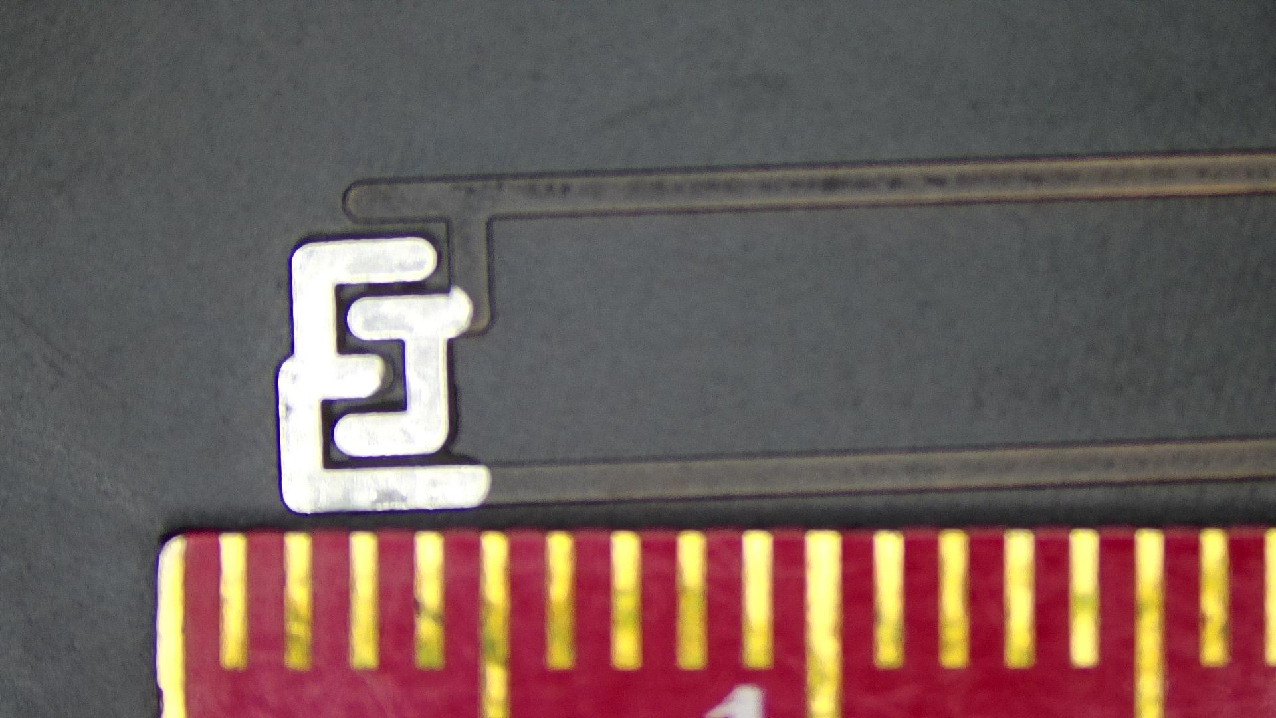
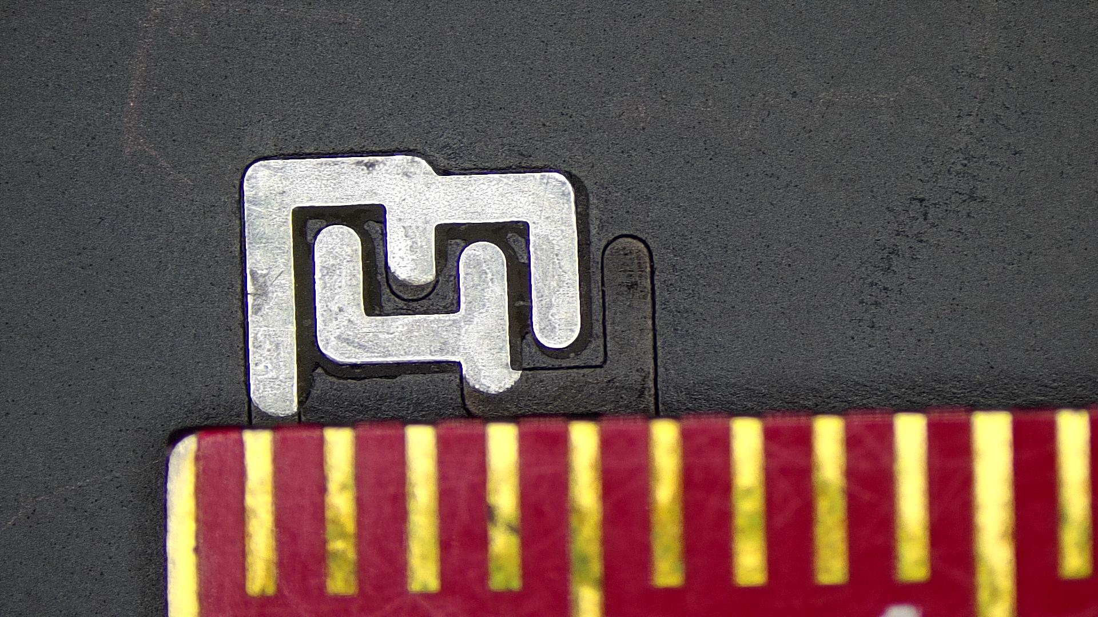
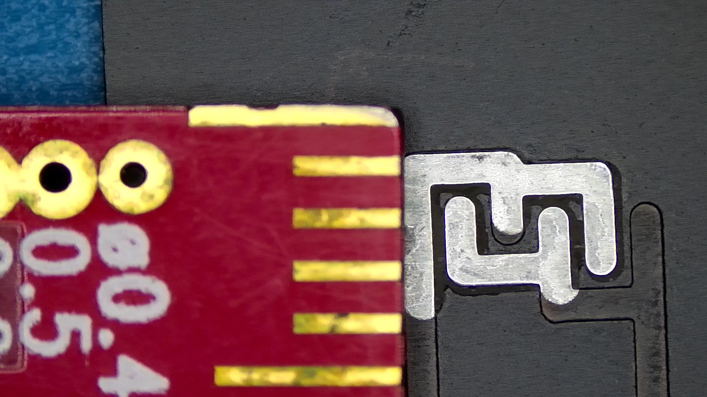
The PCB - Our Process
Took measurements of metal pieces to know the exact dimensions needed for the PCB
Measured thickness of the Huntercat to determine the right thickness for our PCB
Figured out the exact components needed for the board

Slide 20
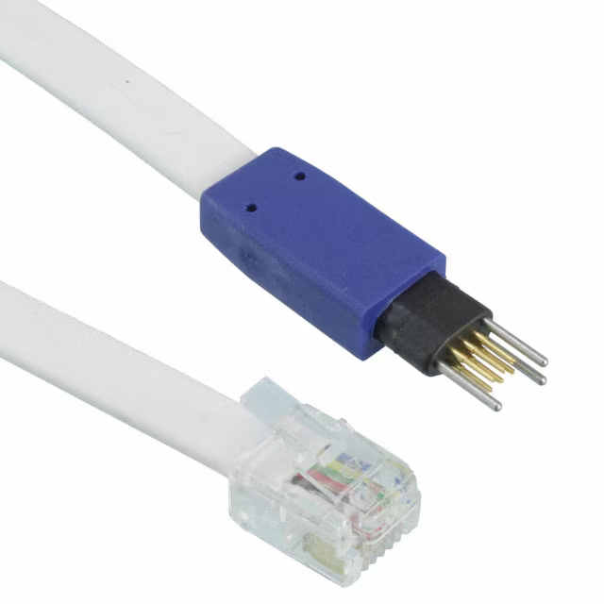
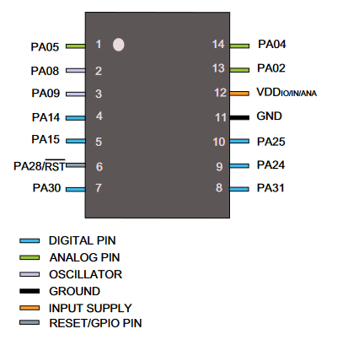
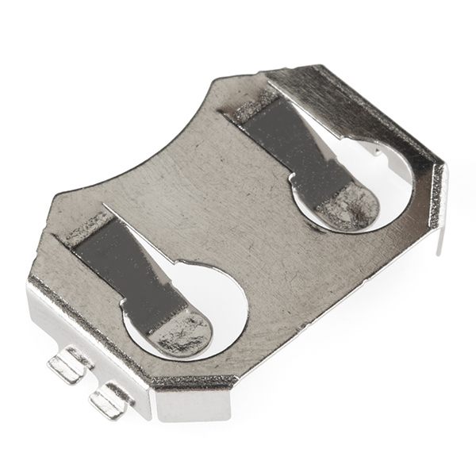
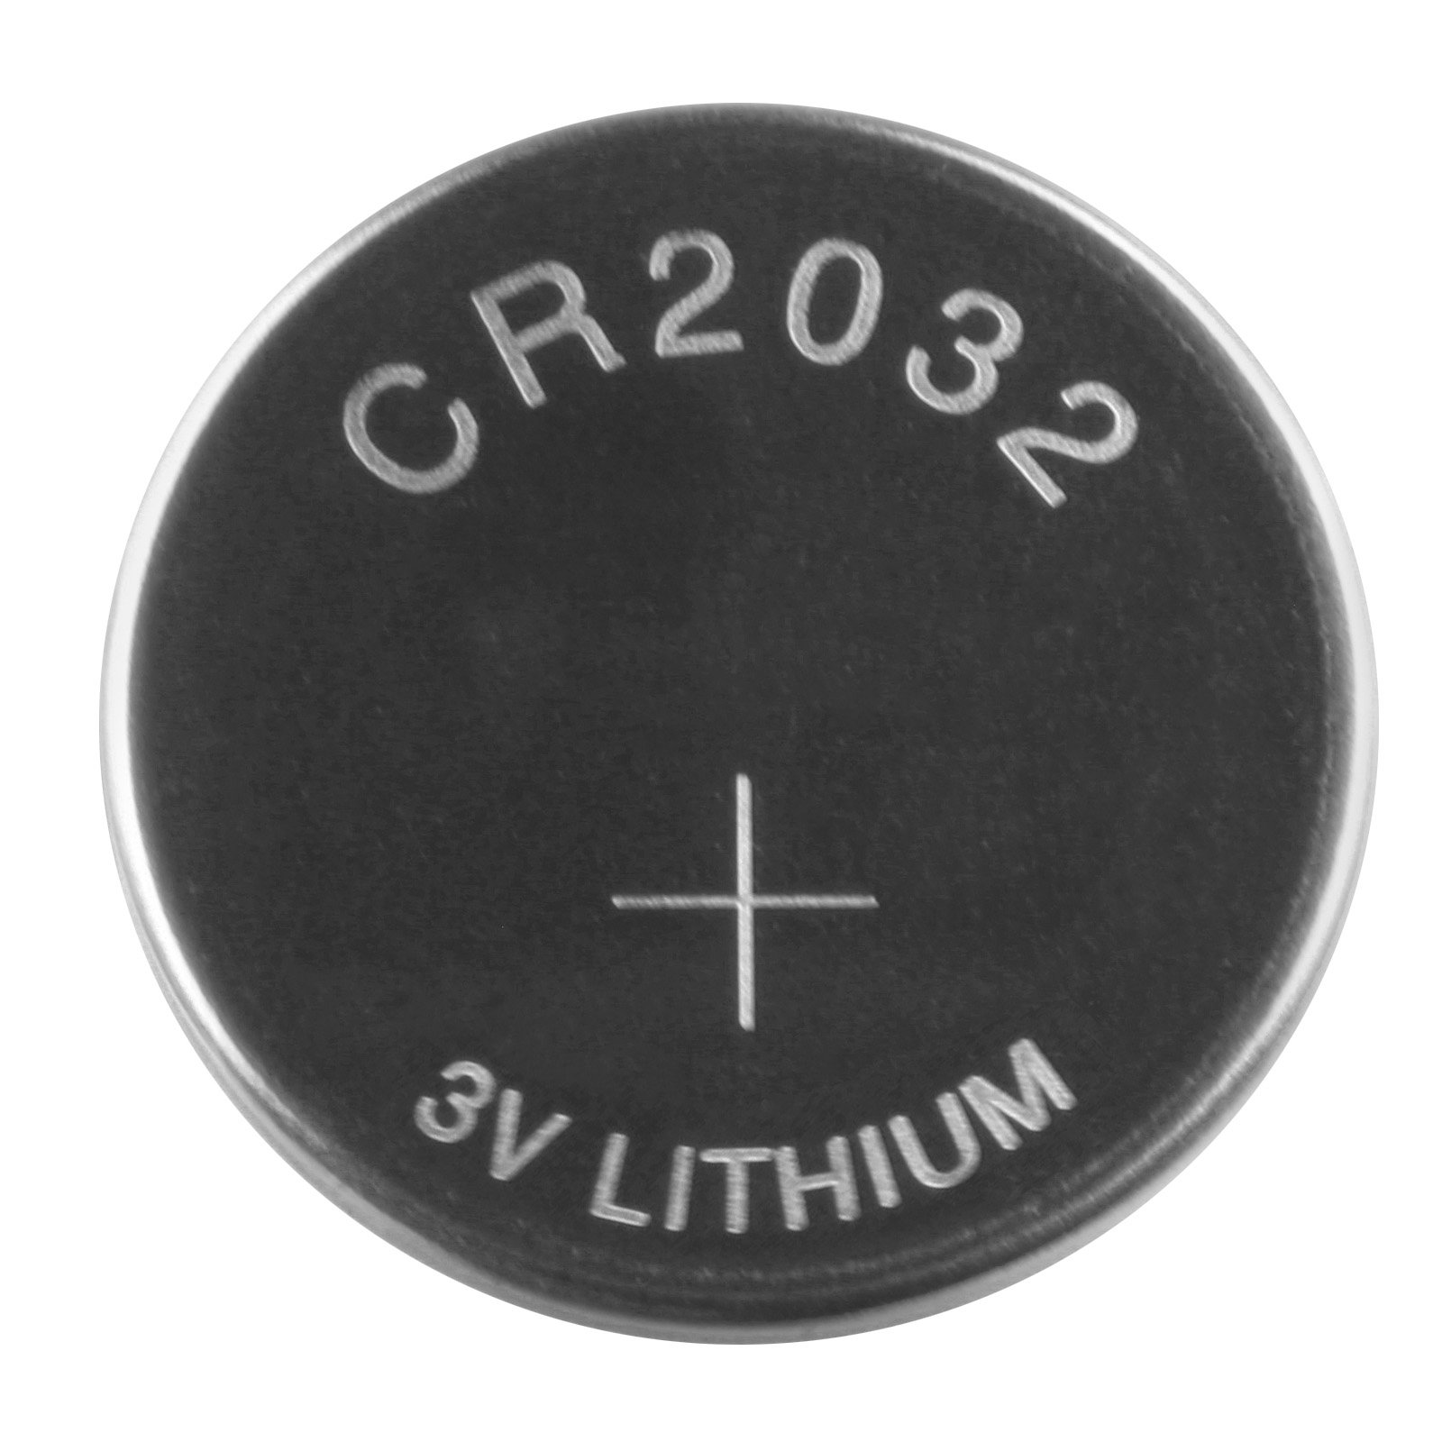
The PCB - Components
Capacitor
(3) LEDs
Programming Cable (TC2030)
(3) 3.3k Resistors
Push button
Battery holder (CR2032)
(4) metal pieces
SAM D11C 14-pin

Slide 21
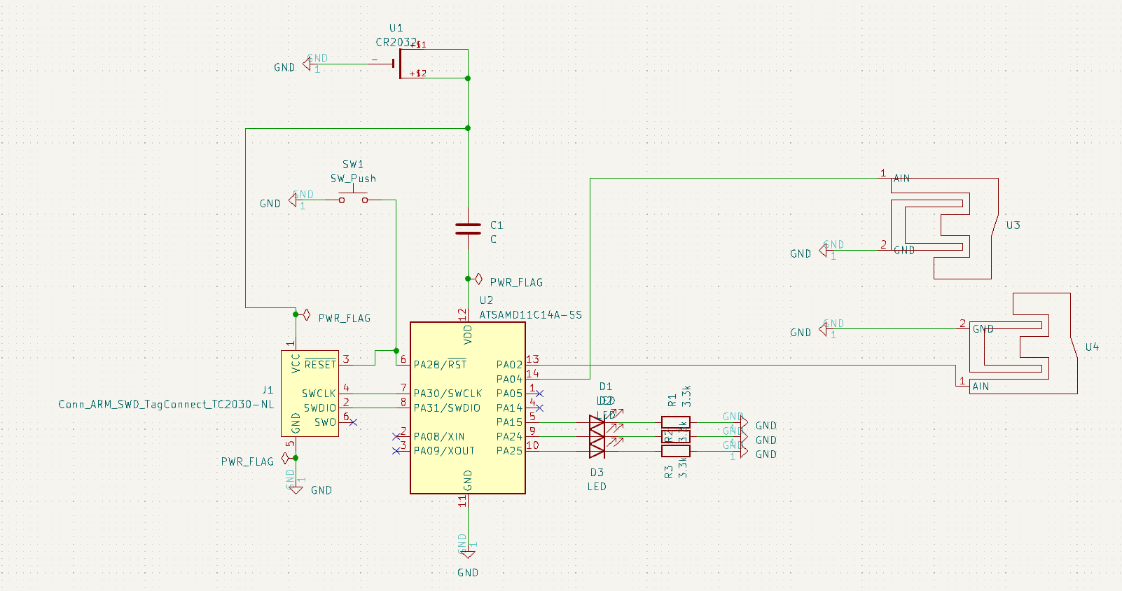
The PCB Schematic

Slide 22
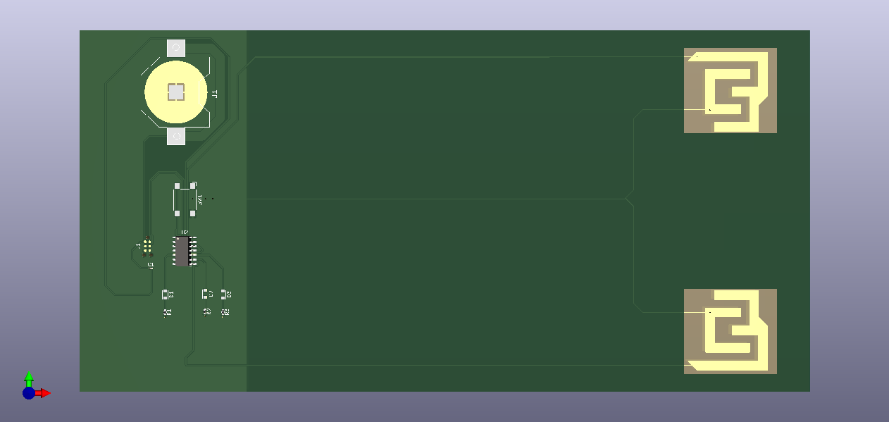
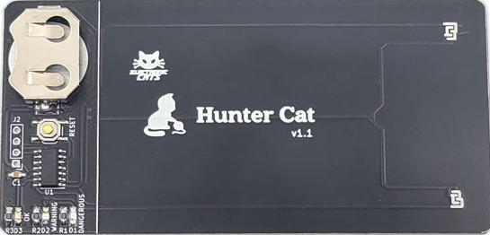
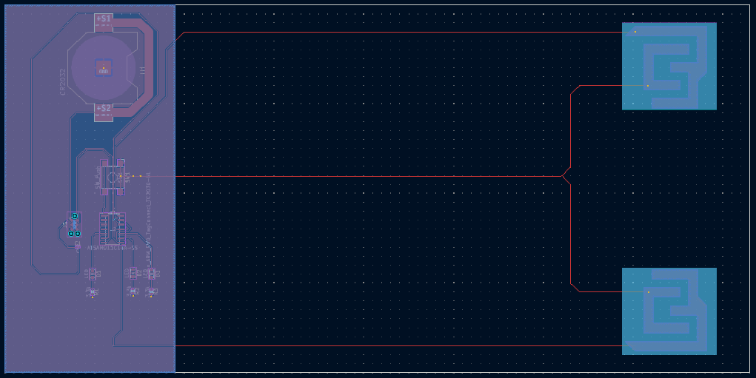


Slide 23

Constraints & Takeaways from the Process
Unable to buy a skimmer!
Had to extrapolate and assume some data
Nowadays, many new types of payment that are better than magstripe
Mobile wallet
RFID, AKA tap and go
Lessons Learned
Time management
Conflict resolution
Distributed work schedule
Notes:
Time management: Working in a team required us to manage our time effectively by setting priorities and meeting deadlines. Recognize that we should have communicated more frequently and more openly about the project’s progress.
Conflict Resolution: Developed some conflict resolution skills; learning how to handle disagreements in a constructive and respectful manner. There were a lot of disagreements throughout the project but we remained respectful whenever we addressed them.

Slide 24

Suggestions for Future Pick Up of Project
There’s potential for this project to be picked back up and continued
Groups could use the PCB that we designed to compare its results to existing products (e.g., Hunter Cat)
Expand research outside of magstripes
Explore the possibility to find/buy a skimmer LEGALLY

